Slide 1
Industrial Engineering and Project Management

Slide 2
There is one thing in common between
the modern armed forces, athletes, HR departments, and Silicon Valley tech firms
– they all use tactics and strategies inspired by Frederick Winslow Taylor, often referred to as the “father of scientific management.”

Slide 4
Work Study
Work study is the way of thinking to get a better way of working
Work study is the investigation, by means of a consistent system of the work done in an organization in order to attain the best utilization of resources
Through this module:
Think and explore the ways to make your job easy
Explain how to improve productivity
History
First industrial revolution-Sir Richard Arkwright-importance of training
F.W. Taylor father of modern industrial engineering (Scientific management and work measurement in 1881

Slide 5
He concentrated his activities in the area of maximum production in minimum time and developed a formula
A definite task : the best and correct sequence of operation
A definite time : By stopwatch or from standard data
A definite method : Developed by a detailed experimentation

Slide 6
Scope and objectives of work study
Techniques are widely applicable
Basic objectives:
Improvement in working process
Standardization of procedures
Effective utilization of resources
Efficient and fast material handling
Decision on fare day wages
Better work culture, working environment
To provide an effective control of system
To economies the movement
To increase the productivity

Slide 7
Work Study
Work study is the investigation, by means of consistent system to attain the best possible use of available men, machine, materials, money and time.
The concept of work study:
Q1: How should a job be done?
Q2: How much time a job should take for completion?
A: Method study and time study

Slide 8
Work Study
Time study
Work Management
Method Study
Motion Study
Micro-Motion Study

Slide 9
Time Study
F.W Taylor and his students
Scientific method to any human problem can be attained by selecting a worker for each particular task and then training him soundly
Split up the work into small activities called element
Eliminate all necessary elements
Assign time to each elements
Add an allowance to actual time to cover the time delays
Standardizes the tools and working conditions
Time study is a work measurement technique for recording the times and rate of working for the elements of a specified job carried out under specified conditions and for analyzing the data so as to obtain defined level of the performance.

Slide 10
Time study has also given rise to a firm scientific and calculative opinion on remuneration system
Stick on the following:
Assign each worker a clearly definite task with definite time
Provide standard condition and appliances
Remunerate each worker with large pay when he accomplish his task
He is the loser when he fails

Slide 11
Method study
Method study is a systematic and scientific evaluation of existing and proposed plans and performance of a work and evaluation of improvement through analytical process of critical examination
To find out one best method-
No rule of thump
All methods should be tried in the organization –select the one which gives maximum benefits with the minimum cost.
Can be achieved through standardization of equipment, method and working condition, and training the operators

Slide 12
To determine the best way there are certain parameters right from the procurement of raw materials till the final product is delivered
Objective is to minimize the cost of production and maximize the quality and customer satisfaction

Slide 13
Procedure: SREDIM
Select: the job or operation that needs improvement
Record: all facts, how work is done by chart method
Examine: every aspects of the job;(what, why, where, when, who, and how)
Develop: Review ideas, eliminate, simply, combine, re arrange, make new methods, chart new method, submit for approval
Install: consider best time to introduce, convince all, train users
Maintain: check frequently, match results, correct deviations.

Slide 14
Method Study Tools
Explanatory Tools
Pareto Analysis
Fish & Bone Diagram
PERT charts
Recording and Analysis Tools
Outline process chart
Flow charts
Flow diagrams
Worker and Machine Process charts

Slide 15
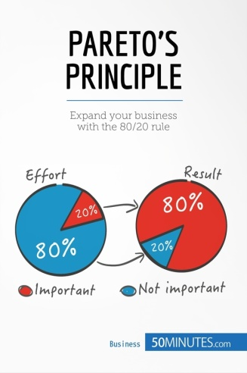
Pareto Principle
States that 80 % of results will come from 20 % of your efforts
It can help us to focus on activities that will have the biggest impact in our business and personal lives

Slide 16
Pareto Analysis example
Taken over a failing service (Business)- host of problems needs to resolve-objective is to increase overall customer satisfaction
Items | Problems | Cause | Score
1 | Phones aren't answered quickly enough. | Too few customer service staff. | 15
2 | Staff seem distracted and under pressure. | Too few customer service staff. | 6
3 | Engineers aren't well organized and often need to book second visits to bring extra parts. | Poor organization and preparation. | 4
4 | Engineers don't know what time they'll arrive. | Poor organization and preparation. | 2
5 | Customer service staff don't always seem to know what they're doing. | Lack of training. | 30

Slide 18
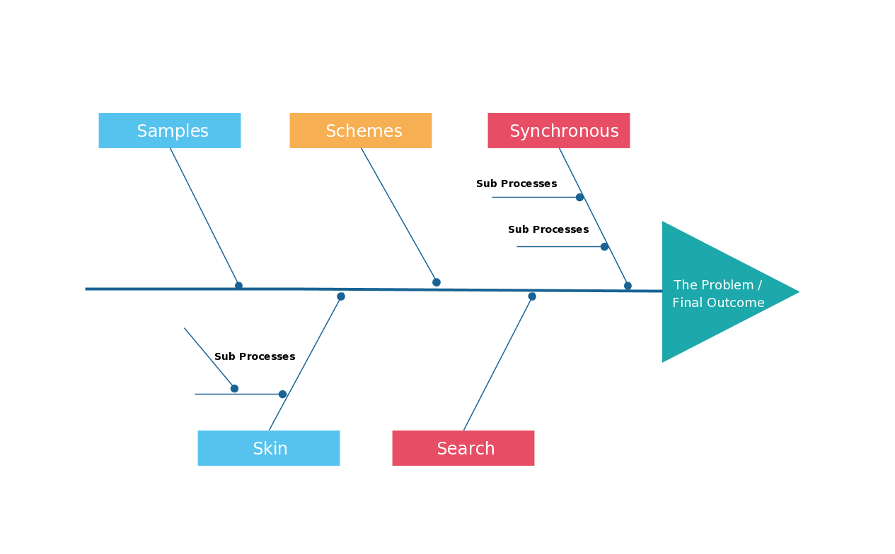
The fish and Bone Diagram

Slide 19
Benefits:
Work simplification
Improved working method
Better product quality
Improved equipment design
Better material handing and lesser material handling cost
Optimum utilization of all resources
Shorter production cycle time

Slide 20
Work Study
Time study
Work Management
Method Study
Motion Study
Micro-Motion Study

Slide 21
Motion study and micro-motion study
Motion study: To find out total movement of employees while they perform a task
Time Study: to find out standard time while performing a task
More detailed investigation of individual operation or operator and layout of materials, parts or tools around a working bench or machine, use of jigs, fixtures and consumables to perform the job effectively
To eliminate wasteful and unproductive movements of workers – to increase their efficiency level
to be conducted with the help of a movie camera

Slide 22
Micro-motion study: This is the most detailed investigation of the movements of hands, arms, limbs, legs, head, etc. while performing the job.
Principles
Principle relating to movement of human body
Principle relating to work station
Principle relating to tool and equipment
Principles of good transportation
Principles of time saving

